Slide 1
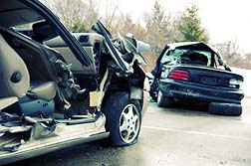
IT 7113 Data Visualization and Dashboard Development Final Project Report Project Title: Road Accident Analysis using different Parameters
Course Instructor: Jack Zheng. G
Term: Spring 2025
Group-9
Team members:
Lalith Aditya Chintham Reddy - 001165714
Swetha Kakaraparthi - 001140442

Slide 2

Overview:
The Road Accident Analysis project focuses on understanding the patterns and contributing factors behind traffic accidents in the United Kingdom from 2019 to 2022. Utilizing a publicly available dataset from Kaggle, the project explores various dimensions including accident severity, vehicle involvement, road types, weather conditions, and geographic locations.
With over 600,000 records, the dataset provides detailed information on the number of casualties, types of vehicles involved, surface and lighting conditions, and accident locations based on latitude and longitude. The goal is to use interactive visual analytics to identify trends, high-risk zones, and underlying causes of accidents.

Slide 3
Objective:
The primary objective of this project is to develop interactive, data-driven
dashboards that analyze and visualize traffic accident trends across the United
Kingdom from 2019 to 2022. The dashboards aim to provide actionable insights into
the factors influencing accident severity, casualty rates, and regional risk
distribution.
Specific goals include:
Identifying year-on-year trends in total accidents and fatalities.
Assessing how different vehicle types, weather conditions, and road surfaces contribute to accident severity.
Highlighting geographic hotspots and high-risk zones through location-based mapping.
Enabling users to filter and drill down into specific accident scenarios based on severity, year, and vehicle type.
Supporting stakeholders in making informed decisions to improve road safety and allocate resources effectively.

Slide 4
Core Analytical Goals:
Examine accident frequency and severity across years, months, and locations.
Detect seasonal or environmental factors that correlate with high casualty rates.
Investigate the relationship between road conditions, lighting, and vehicle type on accident outcomes.
Provide comparative insights into urban vs. rural accident trends.
Visualization and Interactivity Goals:
Design intuitive dashboards that allow users to interact with filters (e.g., accident severity, year, road type).
Use maps, donut charts, bar graphs, line plots, and box plots to display multi-dimensional data clearly.
Offer actionable KPIs (Key Performance Indicators) at a glance, including total casualties, serious injuries, and fatalities.

Slide 5
Broader Impact:
Equip public safety departments and policymakers with visual tools to inform legislation and intervention strategies.
Encourage data-driven public awareness on driving safety, infrastructure planning, and weather-based hazard alerts.
Demonstrate how visualization tools like Tableau can bridge the gap between raw data and real-world application.

Slide 6
Introduction:
Road accidents pose a significant threat to public health and safety, contributing to thousands of fatalities and injuries annually in the United Kingdom. Understanding the patterns, causes, and conditions under which these accidents occur is essential for developing effective road safety strategies.
This project analyzes a comprehensive dataset covering traffic accidents from 2019 to 2022, with over 600,000 records detailing accident severity, casualty counts, weather and road conditions, vehicle types, and precise geographic locations. The data has been sourced from Kaggle and is used to uncover hidden patterns through visual analytics.

Slide 7
By transforming this raw data into interactive Tableau dashboards, we aim to:
Present clear trends and high-risk zones across the UK.
Enable users to explore specific accident conditions and filters (e.g., severity, road type, year).
Support evidence-based decision-making for stakeholders such as traffic agencies, transportation departments, and public policy units.
This introduction lays the foundation for a deeper dive into the methodology, visual designs, and key insights presented throughout this project.

Slide 8

To achieve these objectives, we developed three interactive dashboards in Tableau:
1. Road Accident Overview Dashboard Displays key statistics such as total accidents, casualties by severity, and fatalities by vehicle type, weather, road surface, and region.
2. Trends & High-Risk Areas Dashboard Highlights accident patterns by day of week and light conditions, with maps and charts showing top accident days and locations.
3. Environmental & Vehicle Impact Dashboard Analyzes how weather, road conditions, and vehicle types affect accident severity using bar charts, pie charts, and geographic mapping.

Slide 9
Every dashboard has interactive features, drop-down menus, and dynamic filters to improve user experience and facilitate in-depth investigation. Users can analyze how traffic accidents differ by location, severity, weather, and vehicle type using these dashboards. Users can find certain patterns, trends, and insights pertinent to their analysis needs by engaging with filters. This data visualization project highlights the value of data storytelling in public safety while also showcasing the efficient usage of Tableau for dashboard building. Best practices in layout, interactivity, and accessibility were included in the dashboards' design to make sure users of all backgrounds could quickly examine the data and derive insightful information.
Dashboard Published URL:
https://public.tableau.com/app/profile/lalith.aditya.chintham.reddy/viz/FinalProject_17463851519580/Dashboard1#1

Slide 10
Project Goals and Objective:
Business Context
The United Kingdom has seen fluctuating road accident trends over the years. Accidents vary in severity, location, and timing, often influenced by environmental conditions, road surfaces, and vehicle types. With increasing urban traffic and weather unpredictability, there's a strong need for data-driven strategies to enhance road safety. Visual analytics can help uncover patterns and support better decision-making
User Needs
Our primary users include:
Public safety officials, who need region-specific accident insights to inform safety measures and allocate resources effectively.
Urban planners and transport agencies, focused on improving infrastructure and identifying accident-prone zones.
Data analysts and researchers, who seek to examine the relationships between road conditions, vehicle types, and accident severity.
These users require a visual, interactive system that allows them to filter by year, severity, and geography to analyze accident patterns comprehensively.

Slide 11

Problem Statement
Despite ongoing efforts, the UK continues to report significant numbers of road traffic accidents. Key contributing factors such as poor weather, road surface types, and unsafe driving practices are not always effectively analyzed. There is a gap in accessible, visual analytics that show how these conditions interact and contribute to accidents across time and regions.
Project Goals
Build interactive Tableau dashboards for analyzing road accidents across years and regions.
Identify high-risk conditions such as bad weather, specific road types, or vehicle categories.
Visualize severity-based outcomes and regional accident clusters.
Help users explore trends using filters and drop-downs for deep insight.
Follow best practices in dashboard design and storytelling.

Slide 12

Project Objectives
Use Tableau to design and publish three focused dashboards: Overview, Trend Analysis, and Environmental Impact.
Integrate filters and controls for selecting year, severity, road condition, and vehicle type.
Emphasize accessibility and clean visual layout for diverse users.
Provide actionable KPIs (e.g., total casualties, fatality rate, top regions).
Demonstrate how interactive data visuals can support public safety initiatives.

Slide 13

Methodology
Data Acquisition: Dataset from Kaggle covering UK road accidents (2019–2022).
Data Preparation: Data was clean and structured in CSV format. Minimal preprocessing required.
Exploration & Analysis: Visual analysis to explore severity patterns and environmental links.
Dashboard Development: Built using Tableau Desktop and designed for clarity, interaction, and storytelling.
Publishing & Sharing: Dashboards published to Tableau Public for stakeholder access.

Slide 14

Key Metrics Used
Total Accidents
Fatal, Serious, and Slight Casualties
Accident Severity Distribution
Accidents by Vehicle Type
Accidents by Weather Condition and Road Surface
Location-Based Accident Mapping
Tools and Technologies
Tableau Desktop – for dashboard development and publishing.
Microsoft Excel – used for minor inspection and formatting of raw CSV data.
Kaggle Dataset – primary data source containing all accident records.

Slide 15

Data Description:
The link to the Dataset: https://www.kaggle.com/datasets/charliescott556/uk-vehicle-accidentdatabase-2019-2022/data
Data Source Background
This dataset contains detailed records of road accidents in the United Kingdom from 2019 to 2022. It includes information such as accident severity, number of casualties, types of vehicles involved, environmental conditions, and geographic location (latitude/longitude). The data is well-structured and supports multi-dimensional visual analysis for identifying accident patterns and causal relationships.

Slide 16

Dataset Features
File Format: CSV (Comma-Separated Values)
Number of Records: ~600,000
Number of Columns: 14+
Geographic Scope: United Kingdom (includes coordinates for mapping)

Slide 17
Key Data Attributes
Column Name | Description
Accident_Severity | Classification as Fatal, Serious, or Slight
Number_of_Casualties | Total casualties per incident
Vehicle_Type | Type of vehicle involved (Car, Bus, Motorcycle, etc.)
Weather_Conditions | Rain, Snow, Fog, Clear, etc.
Road_Surface_Conditions | Wet, Dry, Frost, Unknown
Road_Type | Single carriageway, Dual, Roundabout, etc.
Light_Conditions | Daylight, Darkness (lit/unlit)
Accident_Location | Latitude and Longitude for geographic mapping
Year_of_Accident | Year in which the accident occurred

Slide 18

Data Collection and Processing
The dataset was directly downloaded in a clean, analysis-ready format. No additional transformation or preprocessing was required prior to importing into Tableau.
Key Points:
No missing values or formatting issues in main indicators
Structured and normalized, compatible with Tableau
No merging or filtering required
All fields were directly usable as dimensions or measures

Slide 19

Data Modeling and Calculated Fields
To derive deeper insights and support interactivity, several calculated fields were created within Tableau. These fields allowed for more refined analysis, comparison between years, and aggregation by custom logic.
Key Calculated Fields Created:
Year-on-Year % Change Formula used to compare accident trends between current and previous years across KPIs like total accidents and fatalities.
Severity Filter Logic Dynamic parameter allowing users to switch between Fatal, Serious, and Slight accident visualizations across all dashboards.
Vehicle Safety Grouping Custom groupings created for vehicle types (e.g., Agricultural, Private, Commercial) to simplify comparisons and aggregate analysis.

Slide 20
Accident Density Mapping Latitude and longitude fields were used to create heatmaps for visualizing geographic clusters of high accident frequency.
Casualties Breakdown Aggregated fields to separate and count Fatal, Serious, and Slight casualties independently for trend analysis and comparison.
Accident Counts by Weekday Extracted weekday names from accident date fields to evaluate weekly distribution and highlight high-risk days.
Road Type Impact Analysis Customized field aggregating accident counts per road type to assess the safety of different road infrastructures.

Slide 21
Dashboard Design
We created three dashboards to explore road accident patterns:
Road Accident Overview Dashboard: Shows the total number of accidents and casualties, along with accident trends, severity breakdown, and maps of accident locations.
Accidents by Day and Vehicle Safety Dashboard: Displays how accidents vary by day of the week and vehicle type. Includes weekday comparisons, light condition effects, and safety insights by vehicle category.
Environmental & Road Condition Dashboard: Focuses on how weather and road conditions affect accident severity. Includes visualizations for road types, weather conditions, and a map showing accident density.

Slide 22
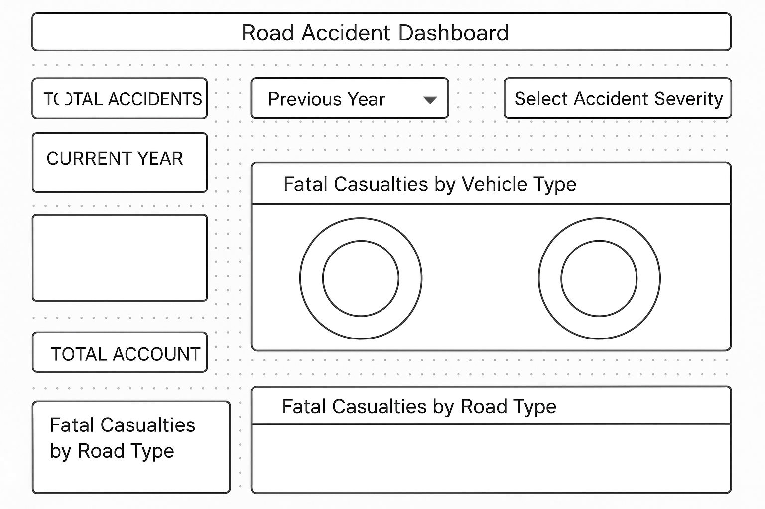
Dashboard 1 Design
Road Accident Dashboard

Slide 23
Wireframe:
The wireframe was created to plan the structure and flow of the Road Accident Dashboard before building it in Tableau. This helped ensure the dashboard was informative, user-friendly, and visually balanced.
Key Components:
Title & Filters Panel: Clearly labeled title and dropdowns to select:
Current and Previous Year
Accident Severity level (Fatal, Serious, Slight)
KPI Cards (Left Column): Display key metrics with YoY changes:
Total Accidents
Total Casualties (Fatal, Serious, Slight)
Monthly trend line charts for each
Vehicle & Environmental Charts (Top-Center Row):
Fatalities by Vehicle Type (icon KPIs)
Fatalities by Weather Condition (Donut chart)
Fatalities by Road Surface (Donut chart)
Location Map (Top-Right):
Interactive map with accident hotspots based on latitude/longitude
Road Type Analysis (Bottom-Center):
Bar chart showing Fatalities by Road Type

Slide 24
Dashboard Details
Goal of the Dashboard:
The primary objective of this dashboard is to provide a comprehensive overview of road accident trends across the UK. It enables users to analyze accident patterns based on casualty severity, vehicle types, road surface, weather conditions, and locations. This dashboard is particularly useful for identifying high-risk zones, evaluating the safety of different vehicle categories, and understanding how environmental factors contribute to road accidents.
Layout
The layout follows a Z-pattern layout for enhanced user engagement:
KPI Cards (Top-Left Vertical Block): Show overall statistics:
Total Accidents
Fatal, Serious, and Slight Casualties
Monthly trends for each severity type
Filter Panel (Top-Right):
Dropdowns for Year Comparison (Current vs. Previous)
Accident Severity Selector

Slide 25
3. Category Breakdown (Middle Row):
Fatalities by Vehicle Type (Icons)
Pie Charts for Weather & Road Surface conditions
4. Spatial & Categorical Insights (Bottom Row):
Left: Fatalities by Road Type (Bar Chart)
Right: Geographic Accident Hotspots (UK Map)
Insights Delivered:
Identifies the most dangerous road types and weather scenarios.
Shows which vehicle types are most involved in fatal crashes.
Reveals monthly and yearly trends in road casualties.
Pinpoints geographical accident hotspots using spatial mapping.

Slide 26
Dashboard Details
Contents
• KPI Cards:
Total Accidents: Total number of recorded road accidents within the selected period.
Fatal Casualties: Total number of deaths resulting from road accidents.
Serious & Slight Casualties: Number of non-fatal injuries, categorized by severity.
Each KPI is accompanied by a monthly trend chart and YoY percentage change for trend comparison.
• Charts & Visuals:
Vehicle Type Icons: Shows fatal casualties by different vehicle types (car, bus, van, etc.), with counts and percentage changes.

Slide 27
Fatalities by Weather & Road Conditions:
Two donut charts depicting the share of fatalities across weather conditions (e.g., Fine, Rain, Snow) and surface types (e.g., Wet, Dry).
Road Type Bar Chart: Horizontal bar chart showing fatal casualties by road type, ranked from highest to lowest.
• Map:
Fatalities by Location: Interactive UK map using red dots to represent locations of fatal accidents.
Users can hover or zoom to explore hotspot regions and geographic clusters.
• Filters:
Accident Severity Selector: Dropdown menu to filter all visuals by Fatal, Serious, or Slight accidents.
Year Toggle: Compare accident trends between current and previous years.
All filters apply globally, updating the entire dashboard in real-time for contextual analysis.

Slide 28
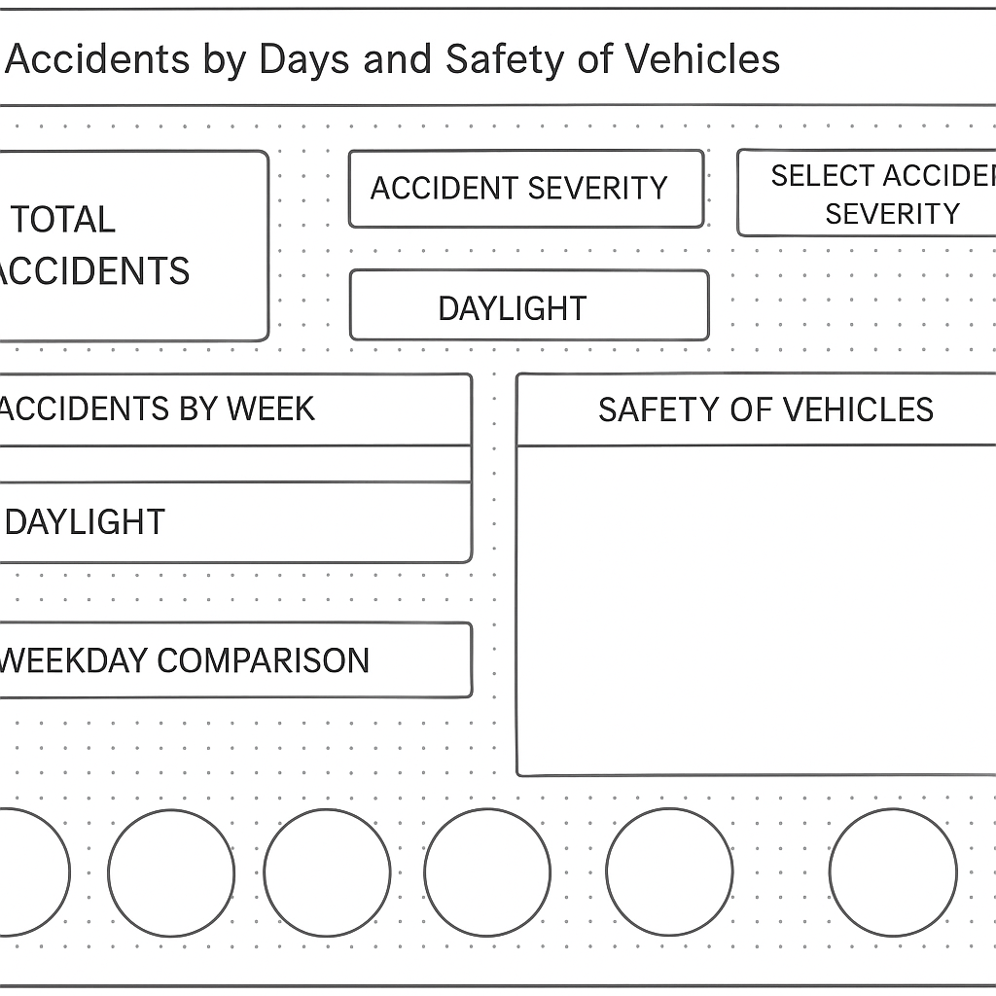
Dashboard 2 Design
Accidents by Days and Safety of Vehicles

Slide 29
Wireframe:
This wireframe outlines the structural design for analyzing accidents by day of the week, lighting conditions, and vehicle type. It focuses on uncovering when accidents are most likely to occur and under what conditions.
Top Left: Total Accidents KPI and bubble chart showing distribution across light conditions (e.g., daylight, darkness).
Top Right: Stacked bar chart of vehicle type and accident severity.
Middle Left: Bar chart visualizing accidents per weekday (stacked by severity).
Bottom: Comparative donut charts for weekday-level severity distribution.
Center Map: Geographic heatmap showing accident distribution across the UK.
The layout is designed for intuitive comparisons across time (days), context (lighting), and transportation modes.

Slide 30
Dashboard Details
Goal of the Dashboard
This dashboard helps explore how accident frequency and severity are distributed across different days of the week, lighting conditions, and vehicle types. It supports efforts in road safety planning and policy formulation by identifying high-risk days, unsafe light conditions, and vehicle groups with elevated fatality rates.
Layout
Top Section:
KPI: Total accidents.
Bubble Chart: Accidents by light conditions (size represents frequency).
Filter Panel: Filters for accident severity and light conditions.
Middle Section:
Bar Chart: Weekly accident distribution (segmented by severity).
Stacked Bar: Safety of vehicles grouped by type (color-coded by severity).
Map: Location-based clustering of accident hotspots.
Bottom Section:
Donut Charts: Comparative visuals of weekday severity patterns (Fatal, Serious, Slight).

Slide 31

Contents
KPI:
Displays total accident count as a headline metric.
Bubble Chart:
Shows accident counts by light conditions (e.g., daylight vs. darkness with lighting).
Bar Charts:
Weekly accident breakdown: Sunday through Saturday.
Stacked by accident severity (Fatal, Serious, Slight).

Slide 32
Vehicle Safety Chart:
Stacked bar by vehicle category (Car, Motorcycle, Bus, etc.).
Severity segmented using distinct colors.
Donut Charts:
Day-wise circular comparison to highlight high-risk weekdays.
Filters:
Accident Severity Selector: Allows dynamic filtering of all charts.
Light Condition Filter: Interactive color legend for filtering visuals by lighting.
Map:
Geospatial plotting of accident records to highlight regional clusters.

Slide 33
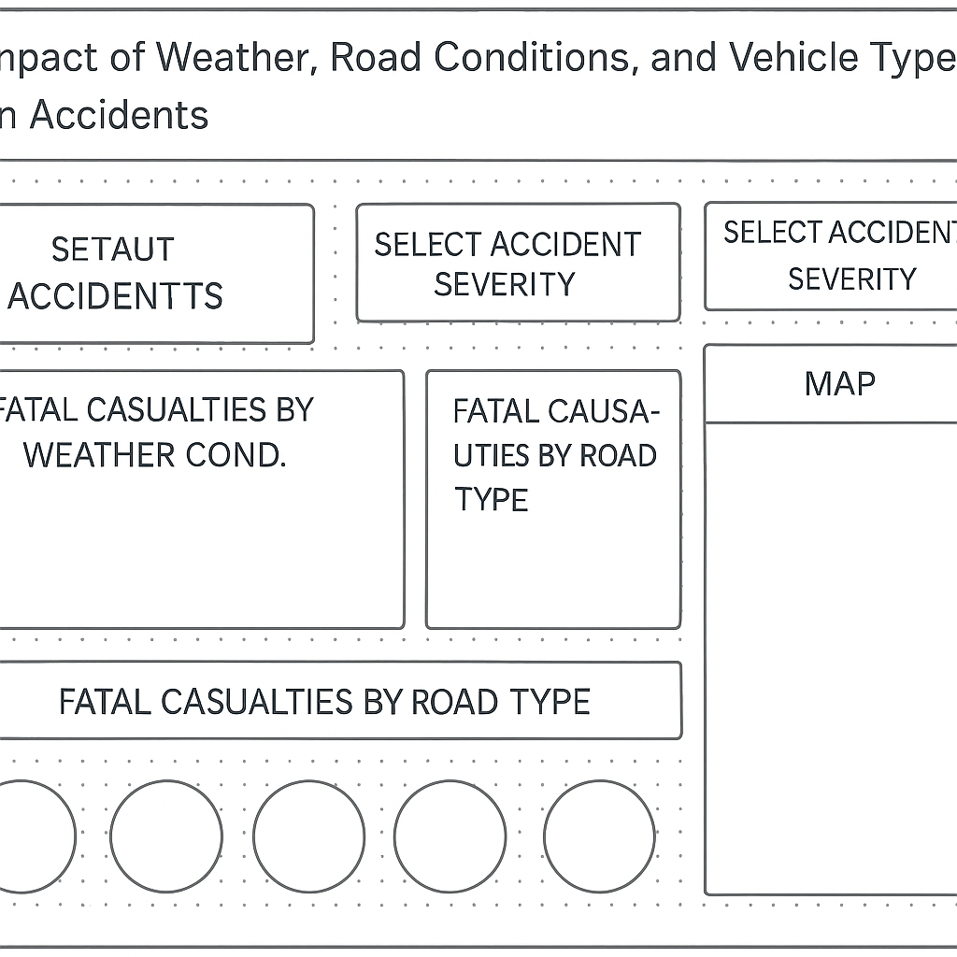
Dashboard 3 Design
Impact of Weather, Road Conditions, and Vehicle Type on Accidents

Slide 34
Wireframe:
This wireframe was designed to structure the dashboard for analyzing how weather conditions, road surface types, and road categories contribute to accident severity and frequency.
Key Elements:
Filters (Top-Right):
Year selectors (Current & Previous Year)
Accident Severity dropdown
Road Type legend
Top Row:
Three Visuals:
Fatalities by Weather Condition (horizontal bar)
Road Surface Breakdown (donut and treemap view)
Map of Fatalities by Location
Bottom Row:
Time-Series Line Chart showing trend comparison for accidents vs. casualties by county.

Slide 35
Dashboard Details
Goal of the Dashboard
To examine how external factors such as weather, road surface conditions, and road types impact fatal accidents. The dashboard aids stakeholders in understanding environmental risks and supports targeted road safety strategies.
Layout
Top Section:
Horizontal bar for Fatal Casualties by Weather
Donut & treemap for Road Surface Types
UK map for Fatalities by Location
Bottom Section:
Time-series line chart comparing accident count vs. casualty count across counties
Filters Panel:
Year of Accident Date (multi-select)
Road Type (highlight by category)
Severity filter for focused analysis

Slide 36
Contents
Weather Breakdown:
Horizontal bar showing fatalities in Fine, Rain, Snow/Fog, and Others conditions.
Road Surface Visualization:
Donut chart showing proportions of Dry, Wet, Frost/Snow, and Unknown surfaces.
Treemap providing a proportional view of the same data.
Map:
UK map with location-wise fatality density (interactive).
Line Chart:
Dual-measure line chart showing trends in accidents and casualties across time/county.

Slide 37
Best Practices Followed
Multi-Faceted View: Integrates spatial, temporal, and categorical views for richer analysis.
Interactive Filtering: Users can select year, severity, and road type to update all visuals in real-time.
Consistent Color Use: Each factor (weather, surface, road type) maintains a consistent palette.
Data Emphasis: Use of simple backgrounds and minimal clutter ensures focus on the data story.
Comparative Trends: The dual-line chart helps compare accident vs. casualty evolution across the dataset.

Slide 38
Data Source View & Processing
The dataset was downloaded from Kaggle and came pre-cleaned, eliminating the need for manual preprocessing or data wrangling.
The data was directly imported into Tableau, which automatically identified data types and dimensions for use in visualization.
Calculated fields created include:
Fatality Rate (%) = (Fatal Casualties / Total Accidents) × 100
YoY Change (%) = ((Current Year Value - Previous Year Value) / Previous Year Value) × 100
Accidents per Vehicle Type, Casualties per Weather Condition, and Road Type Distributions were computed using aggregation and conditionals.
Advanced Tableau features used:
Filters & Parameters to switch between accident severity levels and years.
Groups & Bins for classifying continuous variables (e.g., accident volume ranges).
Dual-axis charts and map layers to support multi-dimensional comparison.

Slide 39
Dashboard Implementation and Features
Dashboard 1: Road Accident Overview Dashboard
Design Match: Fully implements the planned wireframe structure with effective layout alignment and no major deviations.
Contents:
KPI Cards: Total Accidents, Total Casualties, Fatal/Serious/Slight Casualties with YoY comparison
Icons and Figures: Fatal Casualties by Vehicle Type
Donut Charts:
Fatal Casualties by Weather Condition
Fatal Casualties by Road Surface
Bar Chart: Road Type vs. Fatal Casualties
Map: Geographic distribution of fatal casualties across the UK
Filters:
Year selection (Current vs. Previous)
Accident Severity dropdown
Interactions:
Dropdown filters dynamically update all charts
Hover tooltips on charts (vehicle icons, bars, and maps)
Visual indicators (icons, color-coded YoY trends) for better interpretation
Seamless cross-filtering across charts based on severity selection

Slide 40
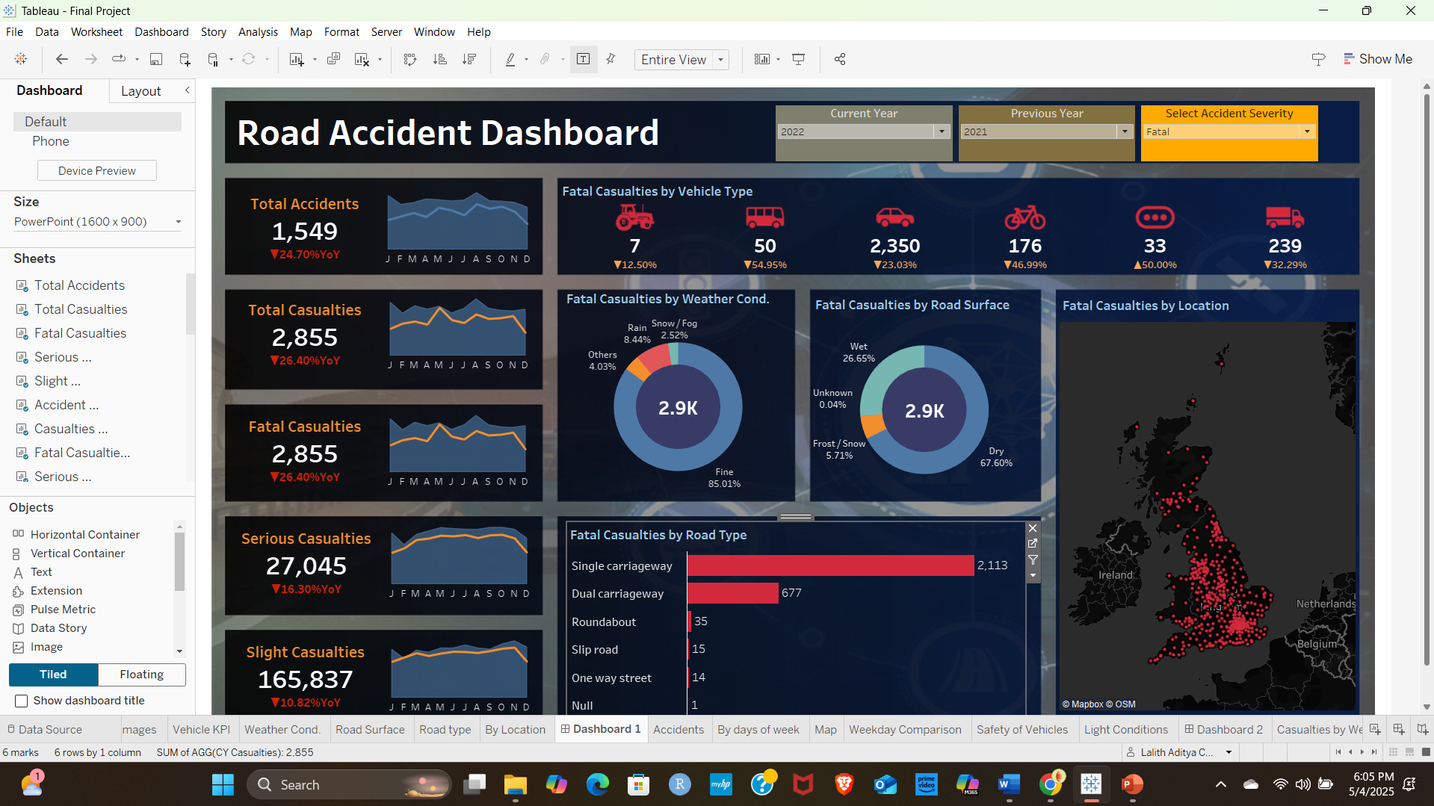
Link to Tableau Public: https://public.tableau.com/app/profile/lalith.aditya.chintham.reddy/viz/FinalProject_17463851519580/Dashboard1

Slide 41
Dashboard 2: Accidents by Days and Safety of Vehicles
Design Match: Closely adheres to the initial layout wireframe, with all visual components properly aligned and functionally integrated.
Contents:
KPI Card: Total number of accidents
Bubble Chart: Accidents by light condition (e.g., daylight, darkness)
Bar Chart: Accidents by day of the week, broken down by severity
Weekday Comparison: Donut charts showing accident counts by day
Map: Geolocation of all accident points
Stacked Bar Chart: Vehicle type vs. total accident severity
Filters:
Dropdown for accident severity
Light condition filters
Year selection for comparative analysis
Interactions:
Hover tooltips show exact counts and categories
Filtering by accident severity dynamically updates all charts
Donut and bar charts highlight weekly and vehicle-specific risk patterns
Geomap interaction supports localized drill-down analysis

Slide 42
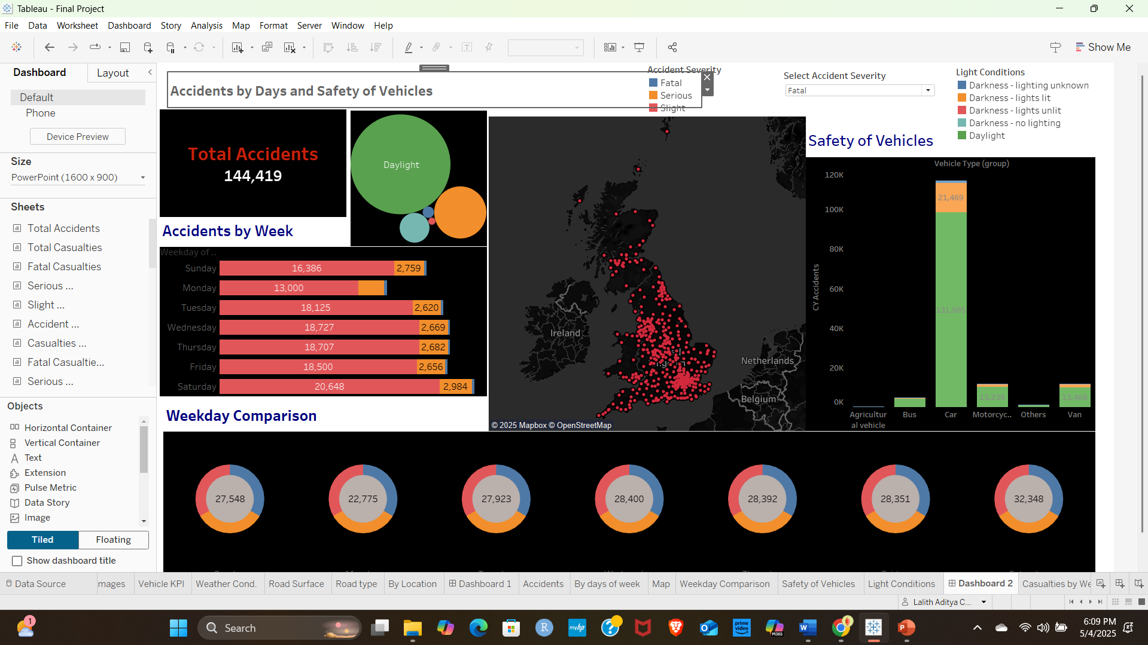
Link to Tableau Public: https://public.tableau.com/app/profile/lalith.aditya.chintham.reddy/viz/FinalProject_17463851519580/Dashboard2#1

Slide 43
Dashboard 3: Impact of Weather, Road Conditions, and Vehicle Type on Accidents
Design Match: Fully aligns with the original wireframe layout, integrating all planned visuals and interactivity features effectively.
Contents:
Bar Chart: Fatal casualties categorized by weather conditions (e.g., fine, rain, fog)
Donut Chart: Fatal casualties by road type (e.g., single carriageway, dual carriageway)
Treemap: Distribution of fatalities by road surface condition (e.g., dry, wet, frost/snow)
Line Graph: Time-series chart comparing CY accidents and casualties
Map: Spatial distribution of fatal accidents across the UK
Filters:
Dropdowns for accident severity, road type, and year
Visual updates tied to selections
Interactions:
Hovering reveals detailed casualty figures
Filters dynamically refresh all charts and maps
Multi-faceted comparison of how weather, surface, and vehicle context affect accidents
Geographic map drill-down enhances regional insight

Slide 44
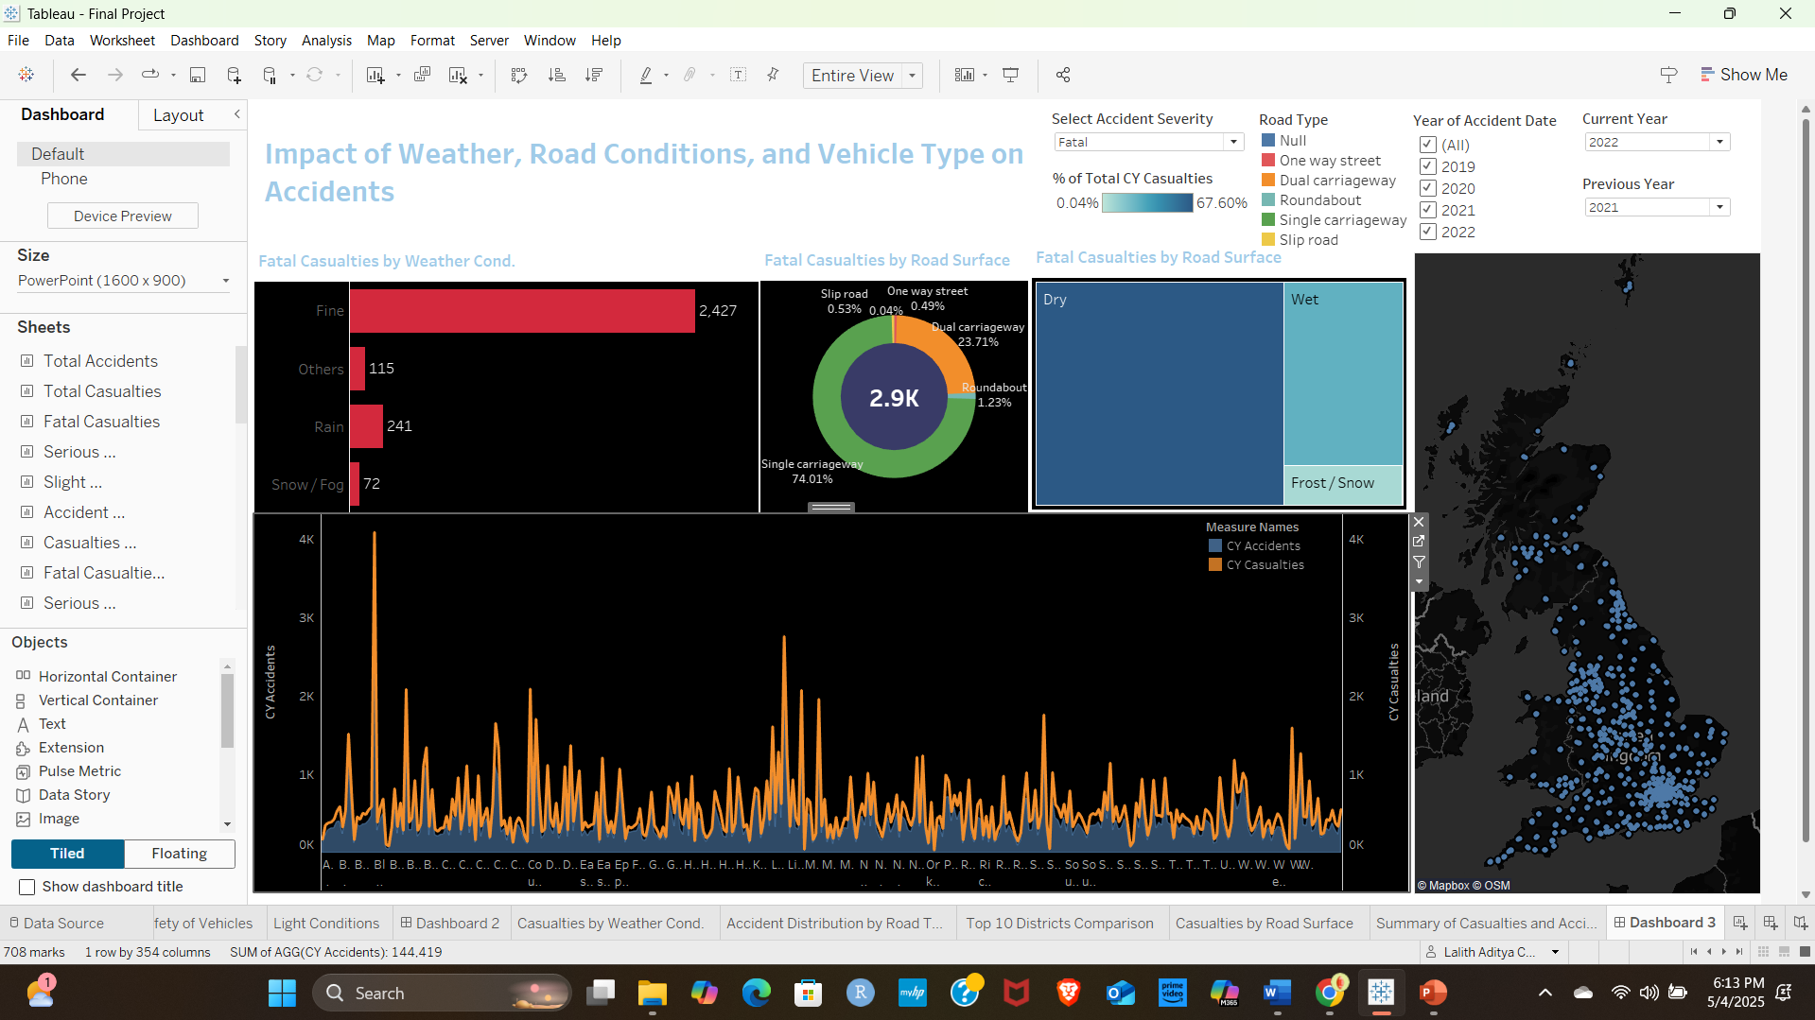
Link to Tableau Public: https://public.tableau.com/app/profile/lalith.aditya.chintham.reddy/viz/FinalProject_17463851519580/Dashboard3#1

Slide 45

Conclusion: Learnings, Challenges, and Reflection
Learnings:
Mastered Tableau techniques for developing multi-dashboard solutions, including time-series analysis, geospatial mapping, KPI card creation, and interactive filtering.
Applied effective visual design strategies such as wireframing, alignment principles (Z-pattern, vertical stacks), color contrast, and layout consistency to guide user experience.
Gained insight into diverse analytical themes, such as pandemic mortality analysis, socioeconomic disparities, road accident factors, and demographic impacts, using real-world datasets.
Learned to design for scalability, ensuring dashboards are readable, performance-optimized, and intuitive even when displaying large volumes of data.

Slide 46
Appendix: Tools, Systems, Data Sources, and References
Tools and Systems Used
Tableau Desktop – For designing, developing, and customizing interactive dashboards.
Tableau Public – For publishing dashboards online and sharing with stakeholders.
Microsoft PowerPoint – For compiling project reports and final presentation deliverables.
Excel / Google Sheets – For initial data exploration, cleaning validation, and structure review.
Kaggle / Government Portals – For sourcing accident and location-level public data.
Data Sources
Kaggle Road Accident Dataset: https://www.kaggle.com/datasets/charliescott556/uk-vehicle-accidentdatabase-2019-2022/data
Data Attributes Included:
Total accidents, fatal/serious/slight casualties
Vehicle types, road types, weather and lighting conditions
Geographic data for location-level mapping
Public Geographic Base Data:
UK OpenMap / OSM (OpenStreetMap) for geolocation mapping
Location coordinates (latitude/longitude) embedded for accident plotting

Slide 47
Learning Resources
Tableau Official Documentation Provided authoritative guidance on Tableau’s features, best practices for dashboard building, calculated fields, and visual formatting.
Instructor Lecture Notes & Class Materials Offered structured understanding of data visualization principles, dashboard interactivity, and use-case-driven design workflows.
YouTube Tutorials & Tableau Community Forums Supplemented learning with hands-on tutorials and troubleshooting guidance on advanced dashboard actions, mapping, and parameter controls.

Slide 48

Thank You

